Slide 1

Employee Attrition

Slide 2
Objective
The main objective of this project is to find the Employees who are going to quit the Company in advance and Reasons for Quitting the Job using machine learning algorithms.

Slide 3
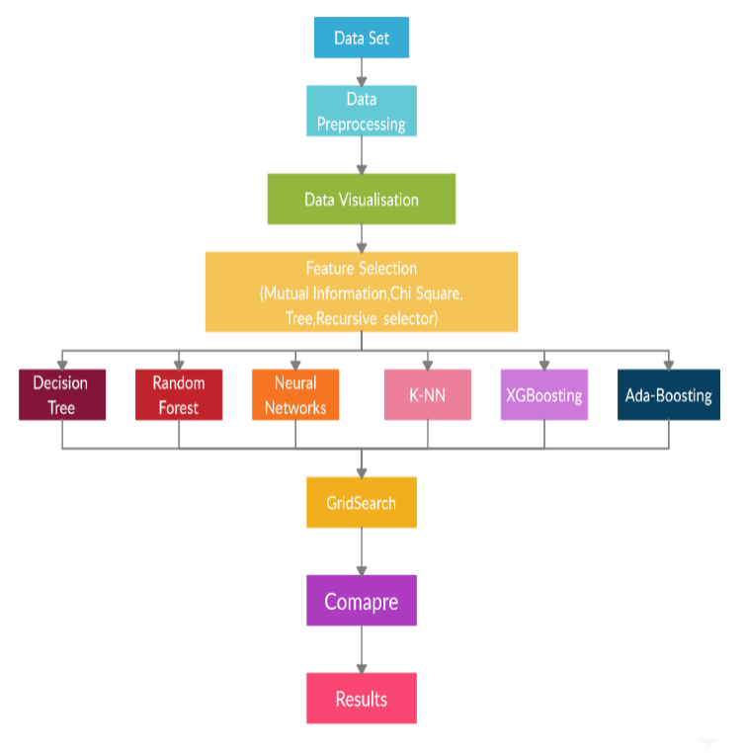
Methodology

Slide 4
Module Description
Dataset is an Employee data set which we obtained from the Kaggle website.
Data Pre-processing :- Here we convert the categorical and ordinal data to numerical Data.
Feature Selection:- By using Multilinear model we remove some of the collinearity features(Similar or derived) from the data set. We also used PCA to make all important variables to form into 3 variables.
Decision Tree, Random forest, Neural Networks , XGB(Xtreme Gradient Boosting), KNN, Ada Boosting :- these are machine learning models.
Grid Search : We use Grid search to find the best parameters for each model.
Compare : Here we will compare all the AUCROC Curves and pick the best model.

Slide 5
Algorithms Used
Decision Tree
Random forest
Neural Networks
XGB(Xtreme Gradient Boosting)
KNN( K- Nearest Neighbourhood)
Ada Boosting

Slide 6
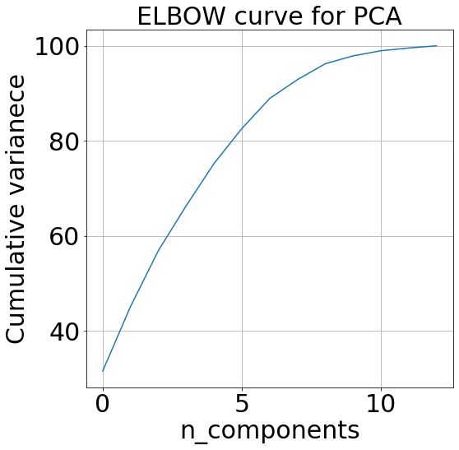
PCA
From using Chi Square , Recursive Selector and Tree Selector we took top 15 features which are common among these three . Now remaining 13 features are present now we will convert these 13 features into 8 Features by using Elbow curve and then we will add these 8 features to 15 features and we will remove these 13 features from data.

Slide 7
Implementation:(Regularization)
In this experiment we find the best parameters using grid search for each classifier, so we also need to find the parameters which should be balanced means should not overfit for data.
The parameters are to be in such a way that the should avoid overfitting and underfitting.
It is possible by doing the operations of this model to this Dataset separately and finding the optimum parameters. After ward we will combine all parameters into a final ensemble model.
Since the main aim of any application is to reduce the Time complexity and Space complexity we go through regularization.

Slide 8
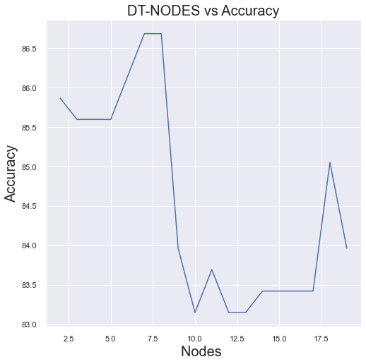
Decision Tree
Regularization
From the graph we observe that the model is Regularized at Nodes = 5 with 86% accuracy. Here nodes means the maximum number of child leaf nodes in each branch at terminating end.

Slide 9
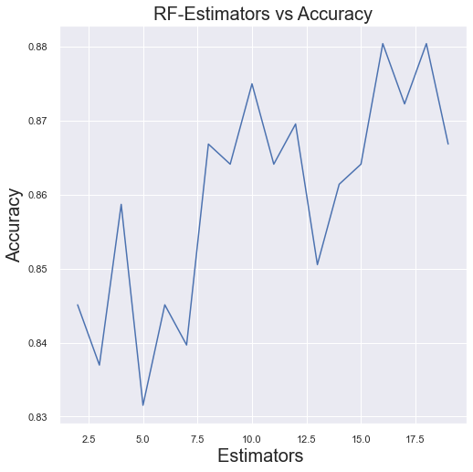
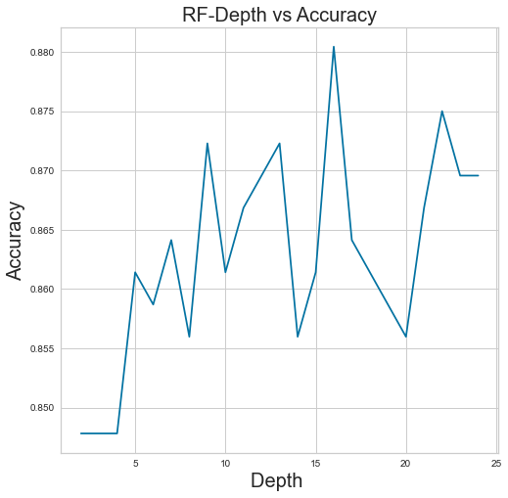
Random forest
Regularization
From the both graphs we observe that the model will be Regularized at
Tree_Depth = 5 with 86% accuracy and No.of Estimators = 10 with 87% accuracy.
So we use this values in final model.

Slide 10
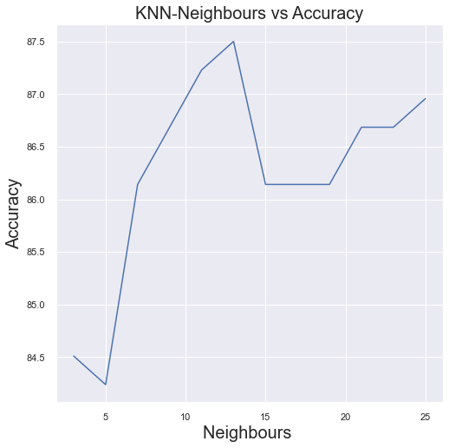
KNN
From the graph we observe that the model is Regularized at Neighbours = 15 with 86% accuracy.

Slide 11
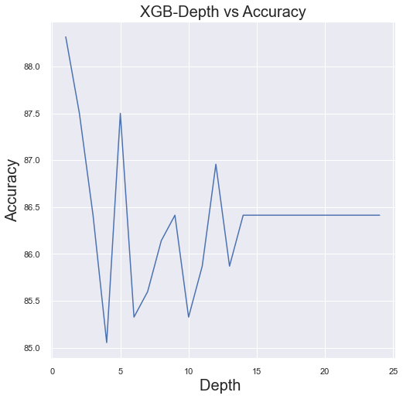
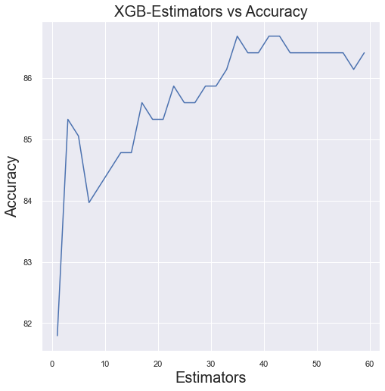
XG Boosting
Regularization
From the graphs we observed that the graph with depth = 15 is regularised very well .
So we can take the 40 estimators with ~ 87% accuracy as the regularized value .

Slide 12
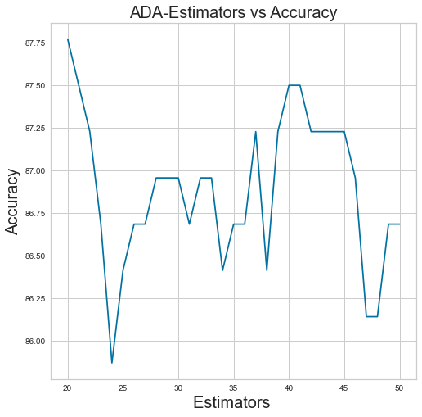
Ada Boosting
Regularization
From the graph we observe that the model is Regularized at Estimator = 30 with 87% accuracy. Here Estimators means the maximum number of child Trees Ensembled.

Slide 13
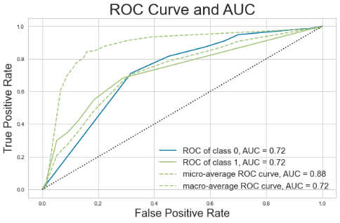
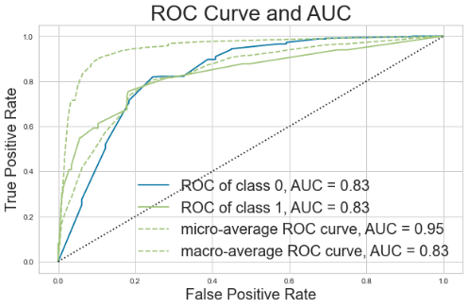
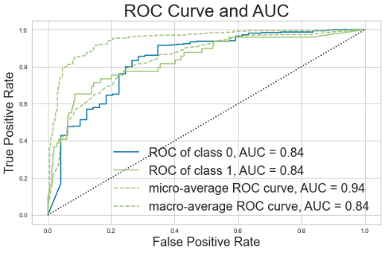
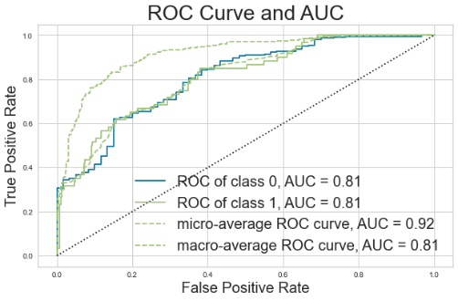
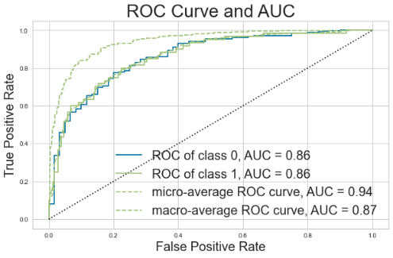
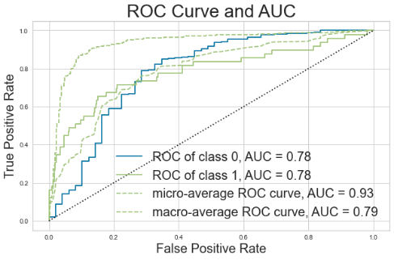
AUCROC Curves for all models.
Decision Tree Random Forest KNN
Neural Networks XG Boosting Ada Boosting

Slide 14
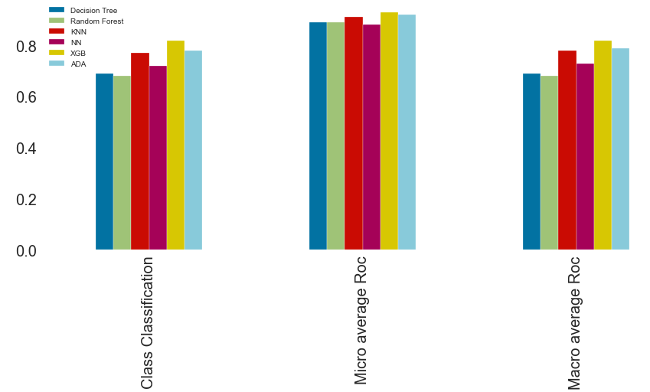
AUCROC Comparison
From the following comparison graph we also observed that the XGB model which is yellow colour is top on three metrics among all models . Here also XGB Outperformed all the other models.

Slide 15
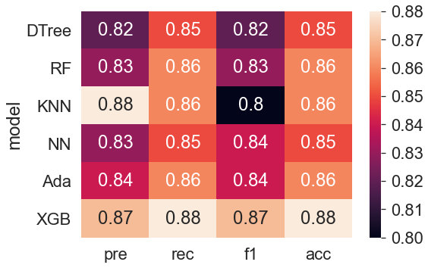
Results
The Results of all Models are drawn in heatmap which is as follows.
From graph we can observe that XGB outperformed all
the other models in all metrics.

Slide 17
THANK YOU

